Slide 1
Task Management system
A real-time insight and visibility to entire organization

Slide 2

Table of Contents
Introduction
Literature Review
Tools Used
Methodology
System Design & Prototype
Implementation
Testing
Conclusion
Future Enhancements
References/Bibliography

Slide 3
INTRODUCTION
Project Introduction
Objective
Problem Statement
Review of scope by industry

Slide 4
Project INTRODUCTION
RealCADENCE™ by Megavision Technologies Pvt Ltd is a SaaS platform that provides real-time insight and visibility to entire organization.
Turns strategies, standard operating procedures, checklists, and tasks into real-time actionable and measurable insight across every level of management.
Using RealCADENCE™ allowed them to digitize all checklists, removing the need for paperwork and providing an interface for the corporate office to communicate directly with the store.
RealCADENCE™ produces a KPI measuring operational execution all location based on scheduled actions.

Slide 5
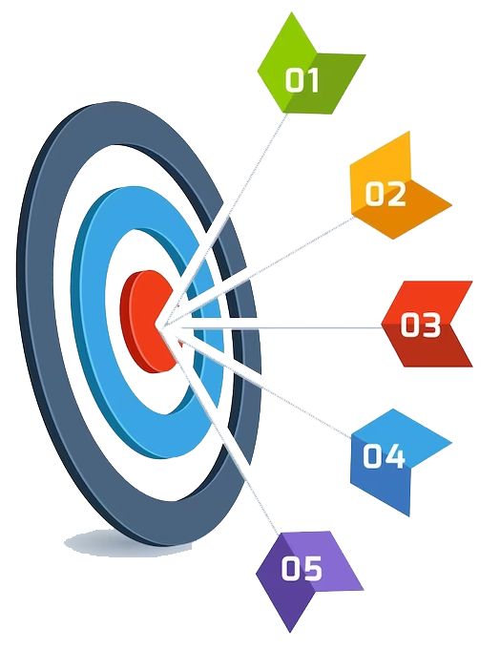
OBJECTIVE
The objectives are as follows:
Digitize work diary and checklists.
Provide all team members with the details of tasks to be completed, by when, and to what standard.
Enable real-time two-way communication between stores/ground level and management.
Reduce management, travel and print costs.

Slide 6

PROBLEM STATEMENT
Lack of real-time insight and visibility across the organization.
The absence of measurement and actionable insights.
Challenges result in operational inefficiencies, communication gaps, and missed opportunities for growth.
Time-consuming communication between corporate offices and various locations.
Traditional methods further exacerbate the problem.
Hampers productivity.
Creates room for Errors & Delays in communication & Execution.

Slide 7

Review of Scope by Industry
The scope of RealCADENCE™ by Megavision Technologies Pvt Ltd has received positive reviews across various industries. Here is a review of its scope in different sectors:
Retail Industry
Hospitality Industry
Manufacturing Industry
Healthcare Industry

Slide 8

Review of Scope by Industry
Retail Industry
RealCADENCE™ has proven to be a game-changer for retail organizations.
It enables real-time visibility into multiple store locations, allowing managers/management to monitor operations, track compliance with standard operating procedures, and communicate efficiently with stores.
The digitization of checklists and tasks, resulting in streamlined processes and improved efficiency.
Overall, RealCADENCE™ has significantly enhanced operational performance and contributed to increased revenue in the retail industry.

Slide 9

Review of Scope by Industry
Hospitality Industry
The platform's real-time insight and visibility capabilities have enabled hotel chains and restaurants to monitor their operations across multiple locations.
The digitization of standard operating procedures and checklists has improved operational consistency and compliance.
RealCADENCE's™ centralized dashboard allows managers to react quickly to issues and communicate effectively with staff members.
The platform's KPI measurement feature has provided valuable data for evaluating operational performance and identifying areas for improvement.

Slide 10
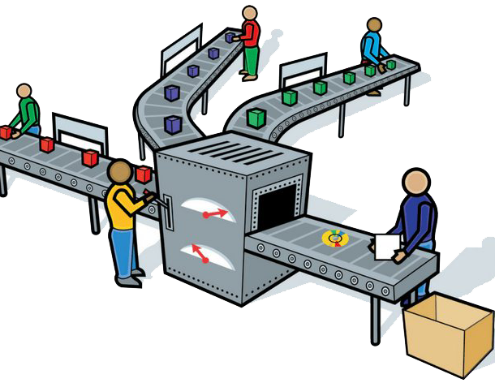
Review of Scope by Industry
Manufacturing Industry
RealCADENCE™ has been instrumental in enhancing operational efficiency in the manufacturing sector.
The platform's real-time insights have enabled manufacturers to monitor production processes, identify bottlenecks, and optimize workflows.
The digitization of standard operating procedures and tasks has improved process consistency and reduced errors.
RealCADENCE's™ data collection capabilities have facilitated comprehensive performance measurement and analysis, leading to data-driven decision-making.
Manufacturers have seen significant improvements in productivity, quality control, and overall operational performance with the implementation of RealCADENCE™.

Slide 11

Review of Scope by Industry
Healthcare Industry
RealCADENCE™ has gained recognition in the healthcare industry for its ability to streamline operations and improve patient care.
The platform's real-time visibility and communication features have enabled healthcare organizations to coordinate activities seamlessly across different departments and locations.
RealCADENCE's™ data collection capabilities have provided valuable insights into patient outcomes, resource allocation, and operational efficiency.
The platform has played a crucial role in improving workflow management, reducing response times, and ultimately enhancing patient satisfaction.

Slide 12
Literature review
Existing System
Proposed System

Slide 13
Literature review
Existing System
The existing system people might have worked on a manual basis. Completing a task is time consuming as well as it increases burden on the employee.
Difficult to manage multiple locations at a time.
Managing Daily store operations is a challenge.
Paper based Operations are giving a tough time.
It is less user-friendly.
It is a time-consuming process.
Very difficult to handle all the reports and invoices.
Organization was not able to gather data at one place.
The system was also not able to sort the data monthly and yearly and calculate the details manually.
Company data could not be handled.

Slide 14

Literature review
Proposed System
The company has developed a solution to address the limitations of the existing system and improve its user-friendliness.
The objective is to streamline the organization's workflow and effectively manage records.
The solution entails creating a user-friendly web and mobile-based system that centralizes all of the organization's products in one place.
This system aims to enhance efficiency and ease of use by addressing the following key points:
Digitize work diaries and checklists, eliminating the need for paper-based documentation.
Provide team members with clear task details, including deadlines and quality standards, ensuring efficient task management.
Facilitate real-time, two-way communication between stores and management, enabling quick and effective collaboration.
Reduce costs associated with management, travel, and printing through the implementation of the digital platform.

Slide 15

Tools used
Tools Selection
Tools Operation
Software Requirements
Hardware Requirements

Slide 16
Tools Used
Tools Selection
Frontend : HTML, CSS, Bootstrap 4, JavaScript, Laravel Framework, Angular JS,
Backend: MySQL Database, Laravel Framework, Angular JS
PHPStorm Code Editor
PhpMyAdmin & Data Grip
Postman

Slide 17
Tools Used
Tools Operation
PHP Storm: To do the Backend, Frontend Coding, UI Designing.
Data Grip: To store the record in MySQL format which is been passed from the frontend/Backend ands provide when it is called.
Postman: To Check the API Response.

Slide 18
Tools Used
Software Requirements
HTML
CSS
JavaScript
Bootstrap 4
PhpMyAdmin
Laravel Framework

Slide 19
Tools Used
Hardware Requirements
Operating System : Windows 10
RAM : 4 GB Minimum
Browser: Chrome version > 90.0.0

Slide 20
Methodology
Agile Methodology
Scheduling of Work Procedure

Slide 21
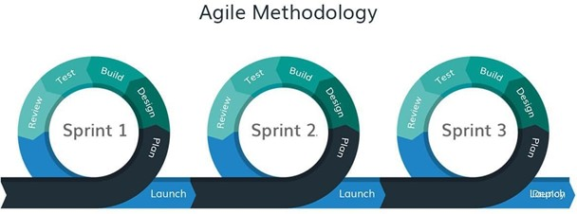
methodology
Agile Methodology
Agile methodology is a flexible and iterative approach to project management and software development. It emphasizes adaptive planning, collaboration, and continuous improvement to deliver high-quality results. RealCADENCE™ by Megavision Technologies Pvt Ltd incorporates Agile principles in its development process.
The primary goal of the Agile model is to enable easy and rapid project completion by maintaining agility throughout the development process.
Each iteration in Agile development involves a cross-functional team of developers working concurrently on different aspects of product development, including:
Planning
Requirements Analysis
Design
Unit Testing
Deployment

Slide 22
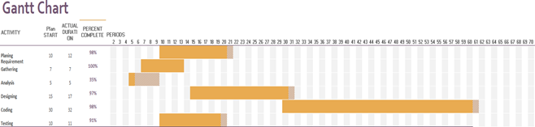
methodology
Scheduling of Work Procedure

Slide 23
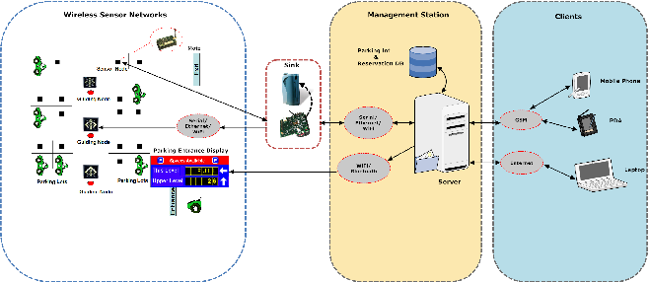
System Design and Prototype
Flow Chart
ER Diagram
Class Diagram
Use Case Diagram
Database Design

Slide 24
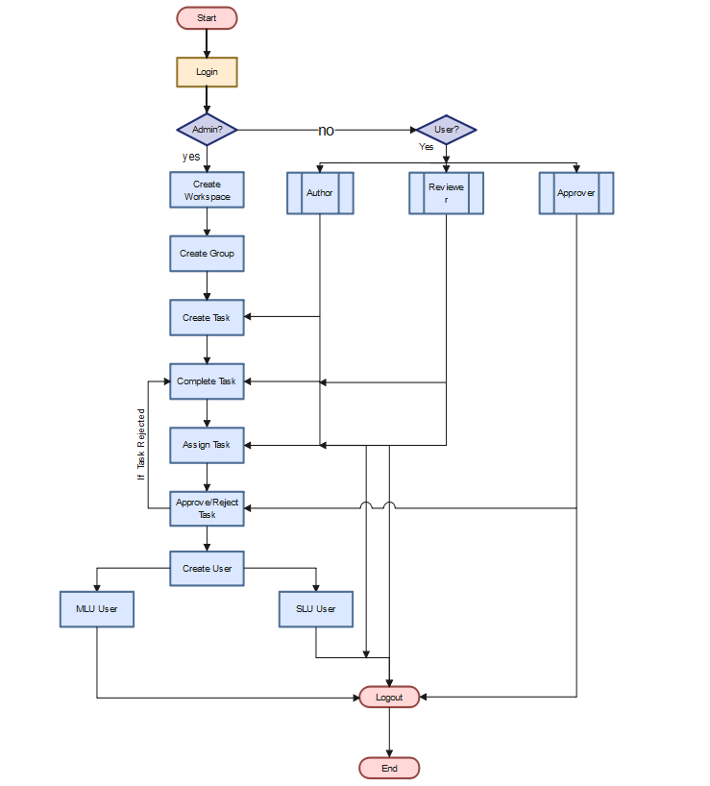
System design and prototype
Flow Chart

Slide 25
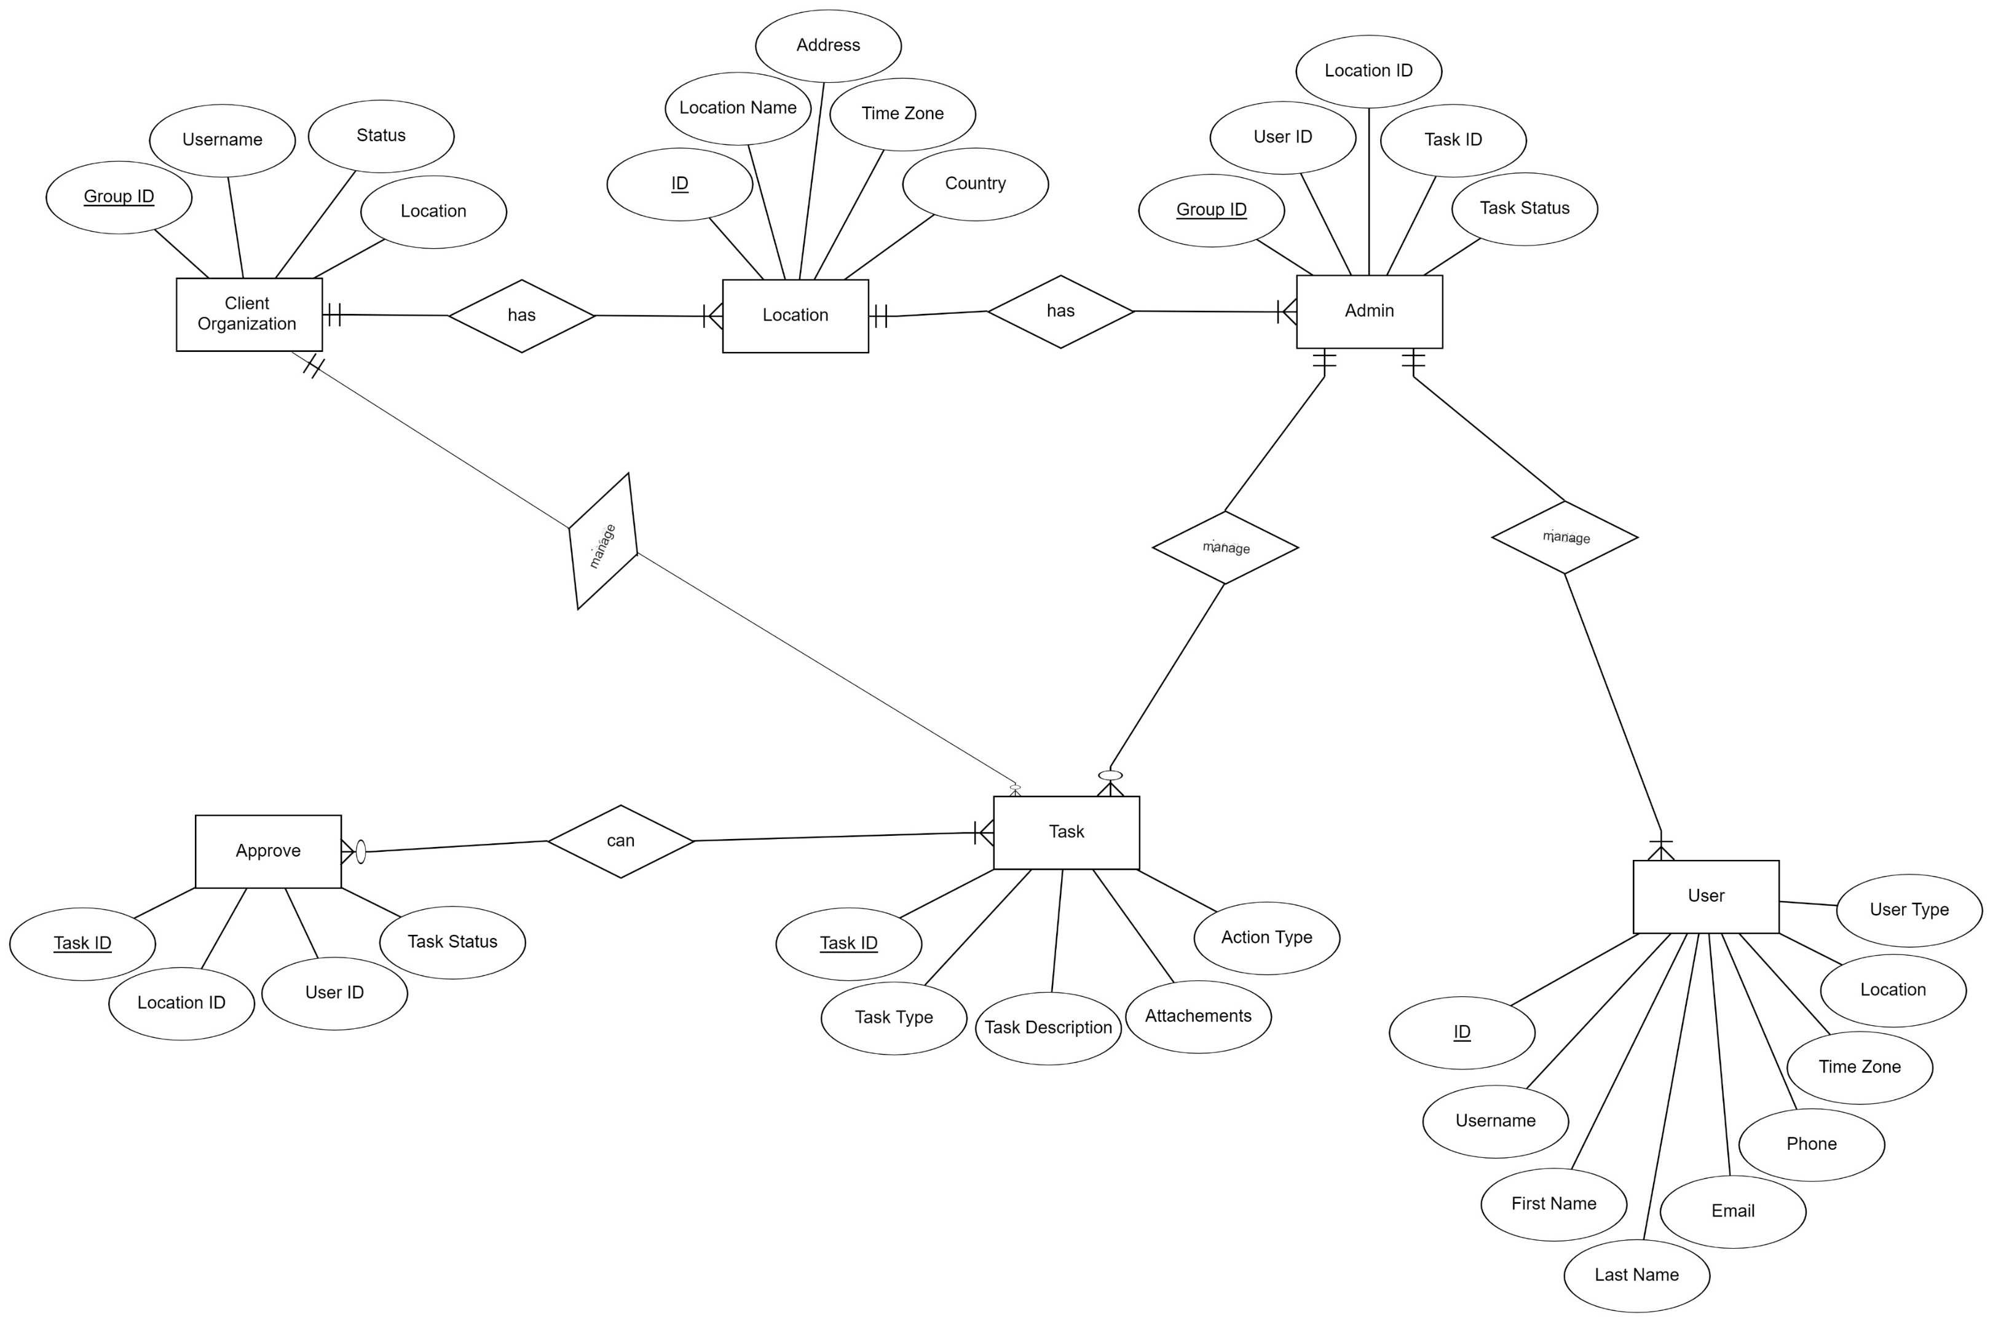
System design and prototype
ER Diagram

Slide 26
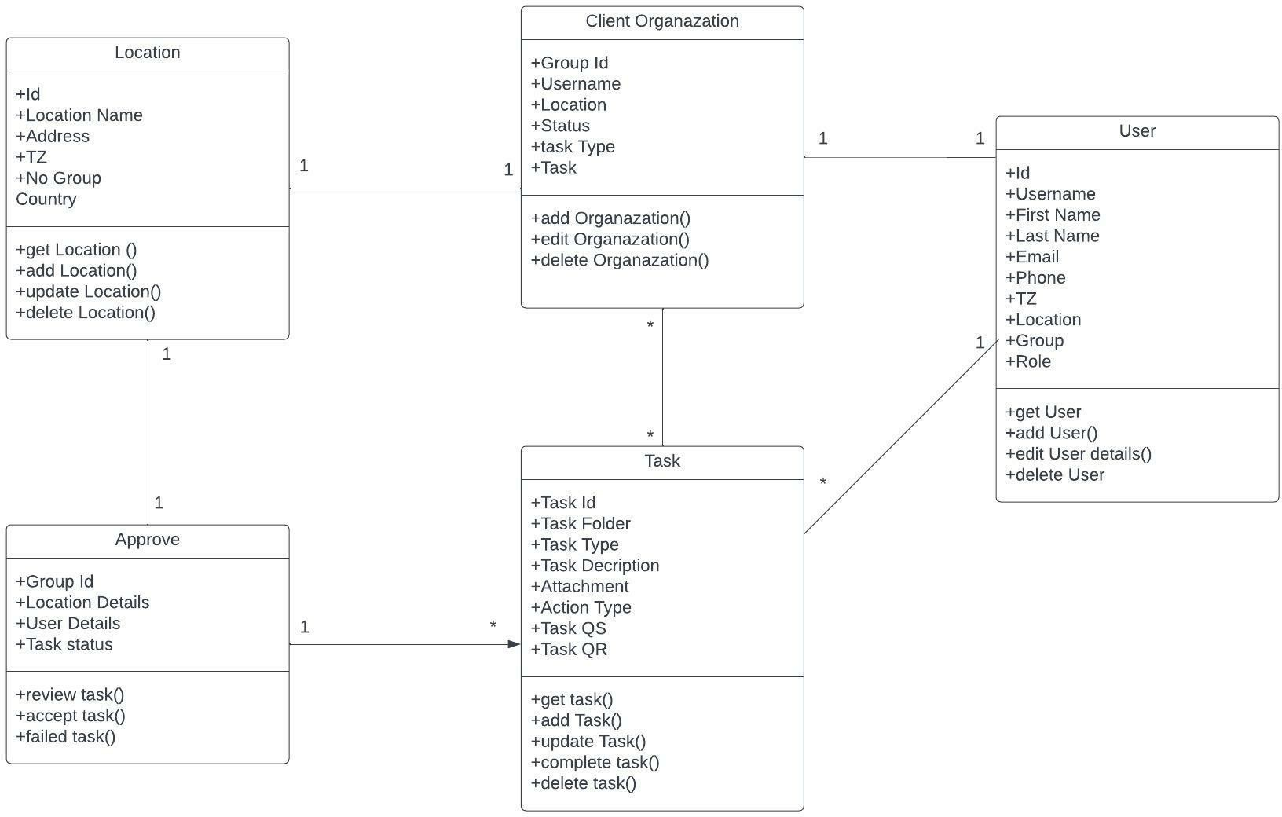
System design and prototype
Class Diagram

Slide 27
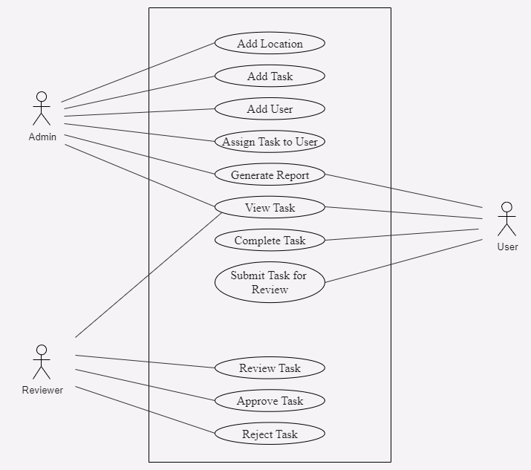
System design and prototype
Use Case Diagram

Slide 28
System design and prototype
Database Design
Table 1 Client Organization
Field | Type
group_id | INT (10) Primary Key
username | Varchar (50)
location | Varchar (40)
status | Varchar (10)
task type | Varchar (20)
task | Varchar (200)
Table 2 Admin
Field | Type
group_id | INT (10) Primary Key
user_id | Varchar (10)
location_id | Varchar (10)
task_id | Varchar (10)
task_status | Varchar (10)

Slide 29
System design and prototype
Database Design
Table 3 User
Table 4 Approve
Field | Type
user_id | INT (10) Primary Key
username | Varchar (50)
first_name | Varchar (50)
last_name | Varchar (50)
email | Varchar (50)
tz | Varchar(100)
locaition | Varchar(30)
group | Varchar(20)
role | Varchar(10)
Field | Type
group_id | INT (10) Primary Key
location_details | Varchar (50)
user_details | Varchar (50)
task_status | Varchar (10)

Slide 30
System design and prototype
Database Design
Table 5 Location
Table 6 Task
Field | Type
location_id | INT (10) Primary Key
location_name | Varchar (50)
address | Varchar (100)
tz | Varchar (100)
member_group | Varchar (50)
country | Varchar(20)
Field | Type
Task_id | INT (10) Primary Key
Task_folder | Varchar (20)
Task_type | Varchar (20)
Task_description | Varchar (100)
Attachment | Varchar (255)
Action_type | Varchar (10)
Task_qs | Varchar (50)
Task_qr | Varchar (30)

Slide 31
implementation

Slide 32

Implementation
Screenshots
Login Page

Slide 33
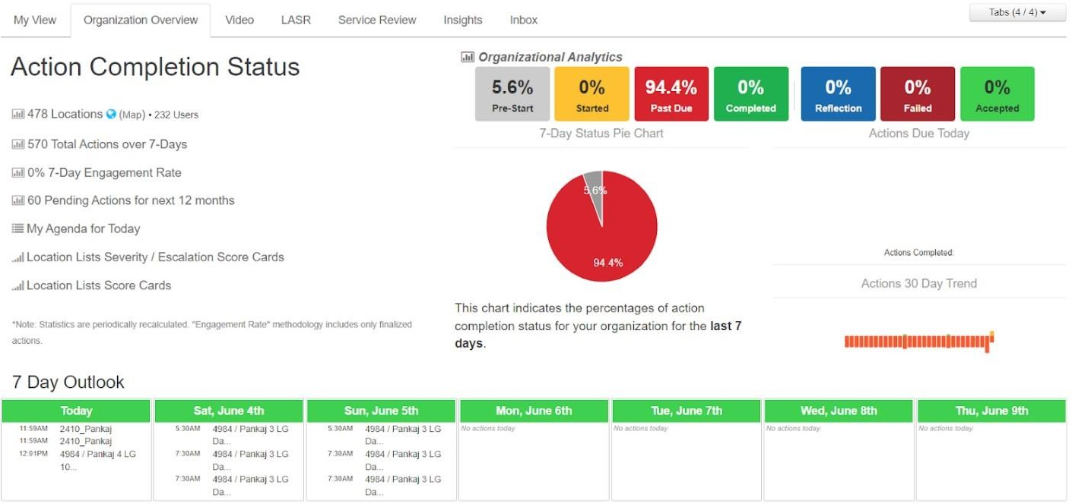
Implementation
Screenshots
User Dashboard

Slide 34
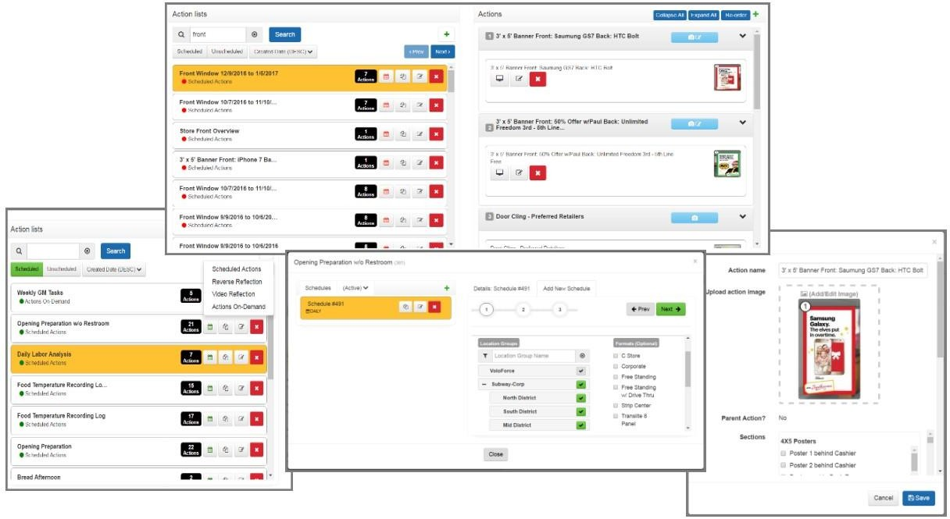
Implementation
Screenshots
Create & Manage Tasks

Slide 35
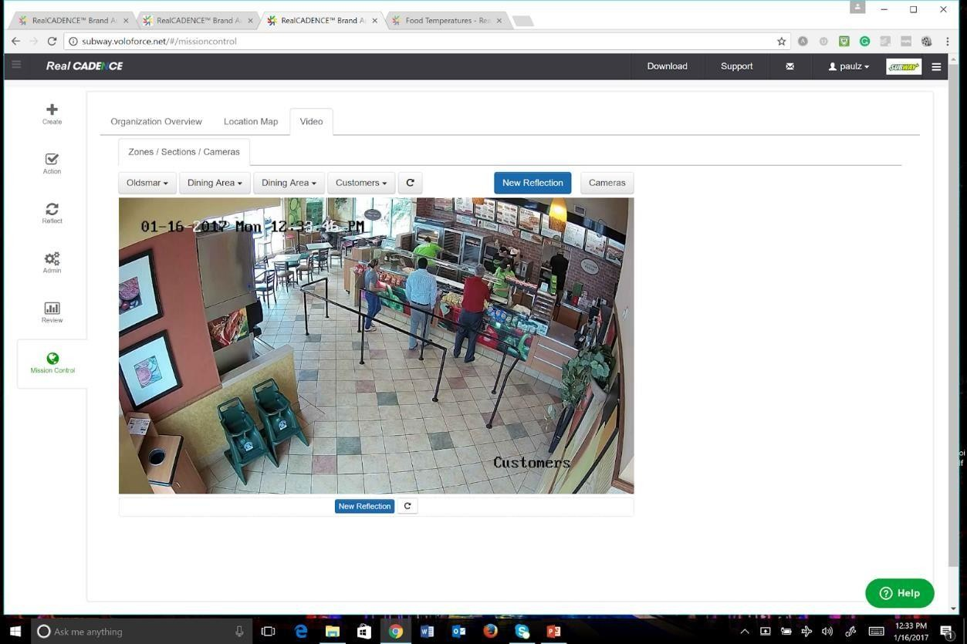
Implementation
Screenshots
Live Camera Action

Slide 36
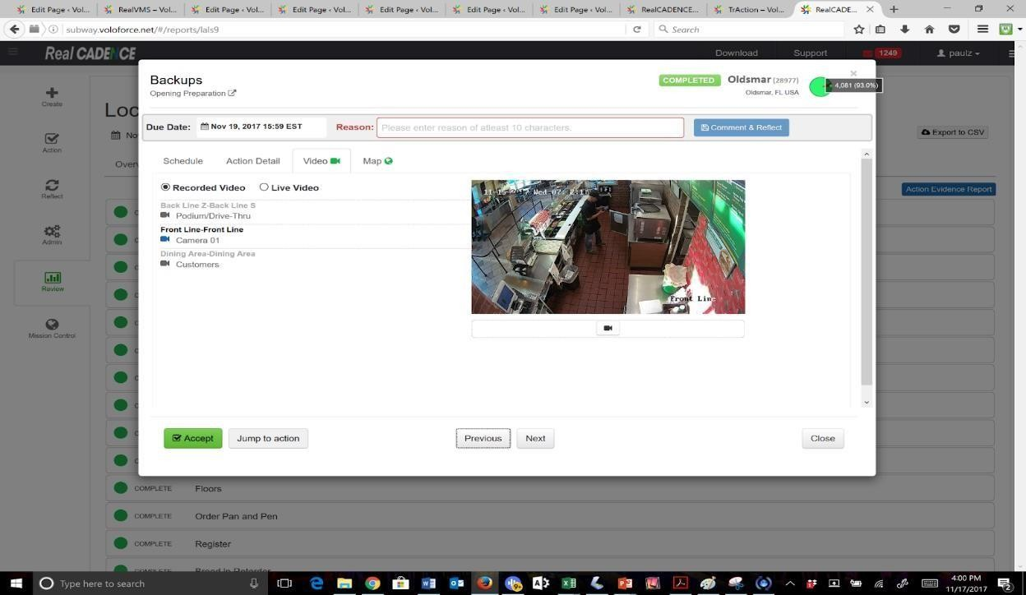
Implementation
Screenshots
Action Worksheet

Slide 37
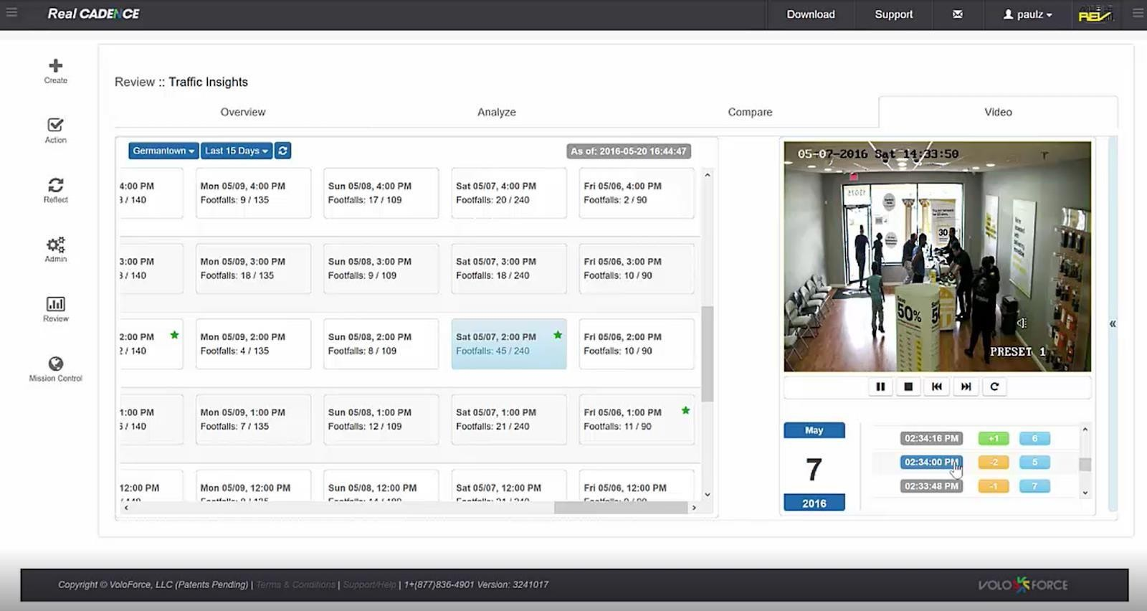
Implementation
Screenshots
Traffic footfall Grid Video

Slide 38
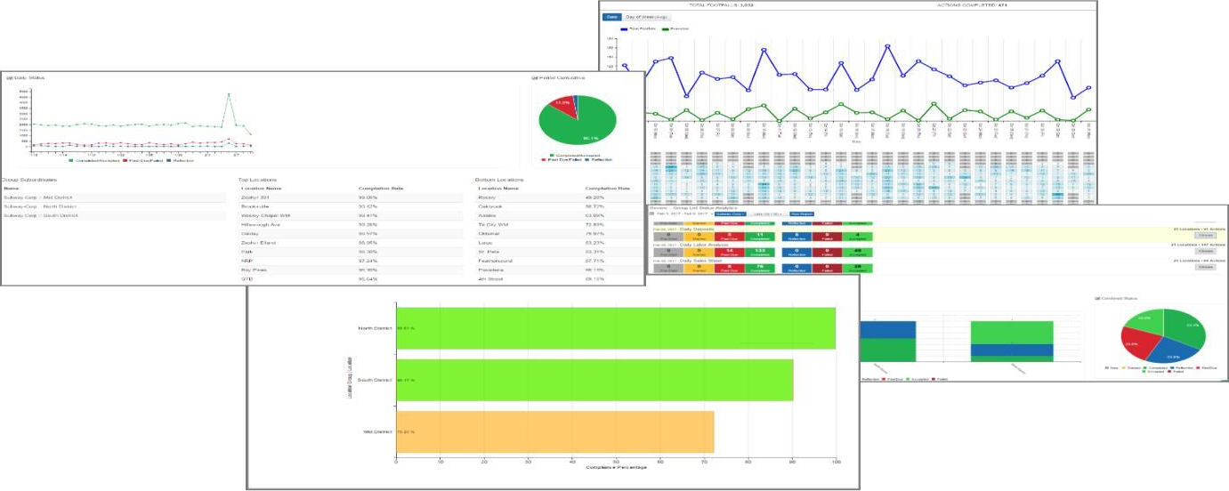
Implementation
Screenshots
Real Traffic Analytics

Slide 39

testing
Black Box Testing
White Box Testing
Unit Testing
Integration Testing
Usability Testing

Slide 40
Conclusion
RealCADENCE™ has implemented a Key Performance Indicator (KPI) system to measure operational execution across all locations based on scheduled actions. The data analysis has revealed a direct correlation between the KPI and revenue generation.
Locations operating at above 90% operational performance have consistently emerged as the top revenue producers, while those operating around the 70% mark have been the poorest revenue earners. This insight has provided clear guidance on where operational efforts should be focused to increase revenue.
To address the performance gaps, the company made strategic decisions to replace store managers whose operational execution remained below 78%.
New managers were appointed after receiving training on the RealCADENCE™ application. These management changes resulted in significant revenue increases of up to 25% for individual locations. Over an 8-week period, the overall operational performance of the entire group improved from 64% to 84%.

Slide 41
Conclusion
By implementing RealCADENCE™ as a management tool, the company has witnessed a significant improvement in operational quality, resulting in substantial revenue gains.
Additionally, the platform has brought about cost savings by reducing travel, paperwork, and training expenses. The company estimates annual paperwork cost savings of $1,200 per location.
The feedback from staff has been overwhelmingly positive, with particular praise given to the user-friendly app, simplified processes compared to the previous diary-based system, and the availability of constant support that provides clear guidance on task requirements.
Overall, RealCADENCE™ has proven to be a valuable tool for enhancing operational performance, driving revenue growth, reducing costs, and fostering a positive user experience within the organization.

Slide 42
Future enhancements
RealCADENCE™ by Megavision Technologies Pvt Ltd is committed to continuous improvement and innovation. The platform will undergo future enhancements to further enhance its capabilities and provide even greater value to organizations. Here are some potential future enhancements for RealCADENCE™:
Advanced Analytics
Machine Learning and AI Integration
Integration with External Systems
Mobile App Enhancements
Customization and Configuration Options
Enhanced Security and Compliance
Integration with Internet of Things (IoT) Devices

Slide 43
References/Bibliography
https://www.Megavision Technologies Pvt Ltd .com/
https://confluencepage.com/
https://Megavision Technologies Pvt Ltd wiki.com/

Slide 44


